Slide 1

We Are The Missing Piece in The Security Lifecycle.
DeployHub: The Post-Deployment Cybersecurity Defense Platform.
E)DeployHub

Slide 2









The New Reality Has a Hidden and Dangerous Cost.
+200%
(/)
·..^{Q}-..⁾,
··₋-₋
.0
C'O
'-
DAYS
Q)
-::,
of all companies now build software on a foundation
of open-source components.
This is the new universal universal standard.
C:
>
The real failure is in our response. It takes over 100 days to fix a single known threat, leaving a massive, undefended attack surface. We are fundamentally too slow.
Last 3 Years
This has led to a 200% spike in open-source vulnerabilities in just the last three years.

Slide 3





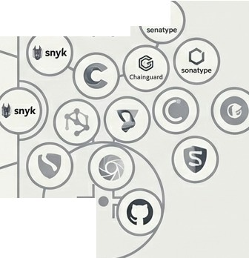








The Entire Industry is Playing Offense.
Build Time Runtime
,,,,,,,......,..---rr ^{L}
0
• •
•
•
7
Today's security tools are great at pre-deployment scanning. They focus on finding issues before code ships. But this is only half the game.

Slide 4
...Leaving an Empty Net Where It Matters Most: In Production.
Once software is deployed, there is effectively zero defensive strategy. The moment of maximum exposure is the moment of minimum protection. This is the industry's critical gap.

Slide 5


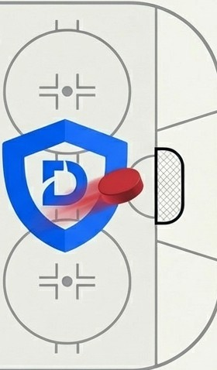


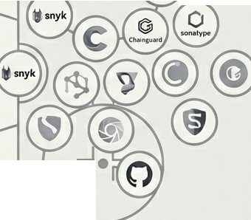






DeployHub is the Defensive Strategy for Software in Production.
Build Time Runtime
- L 0
r senaty
-
•
•
,,,,,,,.......'.---1"
•
•
7
DeployHub is the first Post-Deployment Defense Platform. We pick up where the scanners leave off, providing continua, for the software that's actually running your business. We protect the net.

Slide 6





Granular, Operational Defense in a Single Platform.
.......,...
••• OJ <
"
l!l + 0
o a
« Owlboatd
� DeployHub
-·-
- -
OeployHub UW!r1nterf11ce
-
-$))1
·--
0..-• --
.-.
Track every component
.·-·
Dau•�
0
·--
e-
·- .-. ·-- - ..
--------0
·-
,.,
...
•
.....
·-
1,,,
t)U
·-
....
t>!\
·---
·- -
If
0
"
Mr.llA-
"''
Hll
Emil-IMP
Map all domains and endpoints
--------o
-
-
₋₎-€·
.-
-
0₋
-
0
-
₋o-
0
-0
-0
®
0
₋0
₋0
-
_,,_
·0
View the entire environment map
..
₋0
-
-------'--------0
-
.-...
-·
0
₋0
--
0
·-
..
-⁰-
₋o·
0
e--
e--
e--
..�
·-
-
-
-⁰-
uu
·--
Our platform provides a single source of truth for every component running in your production environment, enabling precise, targeted remediation.

Slide 7
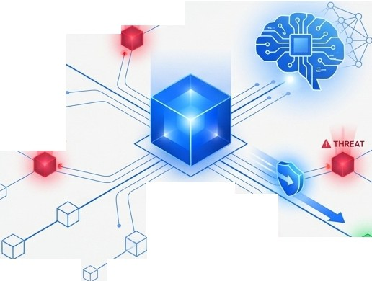


Our Vision:
Self-Defending
�THREAT/"'V"
Software.
We are creating a future where software protects itself. By creating a digital twin of the production environment, we enable Al-driven auto-remediation across edge and cloud-native deployments. We swiftly neutralize threats so your developers aren't waking up at 2 AM to deal with the latest CVE.
..,.,_,,..._ A
THREAT
Digital Twin
A THREAT

Slide 8
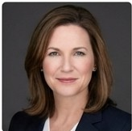
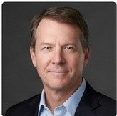
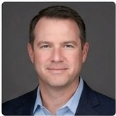
The Pedigree to Redefine an Industry
Tracy [Last Name]
Founder of OpenMake. Board Member, CD Foundation.
Steve [Last Name]
Leader at CloudBees.
Brian [Last Name]
[Role/Accomplishment]
QIOpenMake
C\:, CloudBees ^{□TH}LEINUX
OCD
FOUNDATION
FOUNDATION
We have a track record of building foundational companies and defining the standards that govern software delivery.

Slide 9
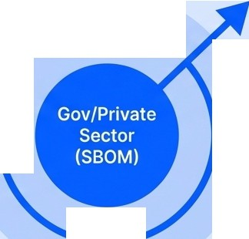

A Targeted Land-and-Expand Go-To-Market.
Full Market Adoption
Initial Target Audience:
Government and Private Sector organizations with mandatory SBOM (Software Bill of Materials) management and auto-remediation requirements.
Broader Enterprise
Key Target Example:
High-compliance environments like Platform One.
Pricing Model:
Straightforward and scalable: $125 per user/month.

Slide 10
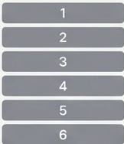


Mature Technology with a Powerful Community Moat
Product Maturity Strategic Moat
TRL 7: System prototype demonstration in an operational environment
�
THE
LINUX
FOUNDATION
Ortelius
TRL7
I I
8
I I
9
We are currently Pre-Revenue, but the platform is at TRL 7.
Our open-source core, Ortelius, is an incubating project at The Linux Foundation.
Why this Matters
We are leveraging the open-source community to build a defensive moat and create a frictionless on-ramp for enterprise adoption.

Slide 11



The Immediate Catalyst: Unlocking a Major Government Contract.
> >
=@
[Investor Funds]
Secure Customer Memorandum of Support
Unlock Direct-to-Phase II SBIR Contract
The Goal: Secure a Customer Memorandum of Support.
The Unlock: This single document unlocks a Direct-to-Phase II SBIR (Small Business Innovation Research) contract with AFWERX.
The Status: We have already identified the AFRL (Air Force Research Laboratory) end-user. We just need to finalize the paperwork.

Slide 12











3M to
e are Raising
Build the Future of Defensive Cybersecurity.
Seed Round

Slide 13
Fueling Growth and Targeting a $100M Series A
Use of Funds
,⁰, Hire 3 developers to build out our Al automated response capabilities.
Scale our Go-To-Market team to execute on the land-and-expand strategy.
g:]>
Secure SBIRContract
Scale GTM
Achieve the key metrics for
^{�ea}$100M Series A
Year 1
Year 2
-�
�•
First Enterprise Customers, Perfect Al Response Engine
Expand into new verticals
round.

Slide 14

Let's Build the Future of Defense.
[Name of Primary Contact]
[Title]
[Email Address] [Phone Number]
Scan to connect or visit our website.
DeployHub, Inc.
[Website URL]

Slide 15


Appendix: The Cybersecurity Tooling Landscape
Build Time/ Offense
Focus on code scanning, dependency checking, and container analysis before deployment.
Runtime / Defense
The only platform focused on
post-deployment visibility, detection, and auto-remediation in live environments.
snyk:
Osonatype
C Chainguard
DeployHub

